Slide 1







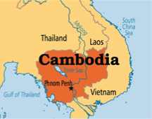
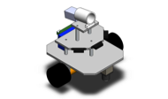
Sherry Liang Mechanical Engineering Design Portfolio
Education
Bachelor of Engineering,
Mechanical Engineering 2010
Master of Engineering,
Aerospace Engineering 2017
Mechanical Engineer
Master of Science,
Mechanical Engineering 2013
About Me
My interests, research, and experience lies in product design and development, including computational aided engineering analysis and testing.
My career aspiration is to become proficient with the design process from the initial stages of concept design to analysis and testing, becoming a technical expert, and contributing innovative solutions to create and improve on products.

Slide 2
GE Aviation BB2C Rockwell Collins College Projects

Slide 3

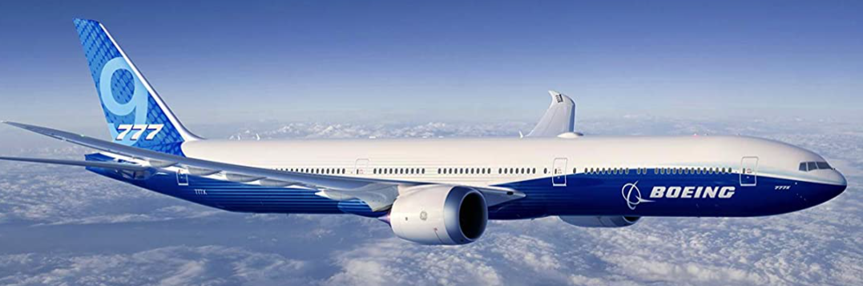
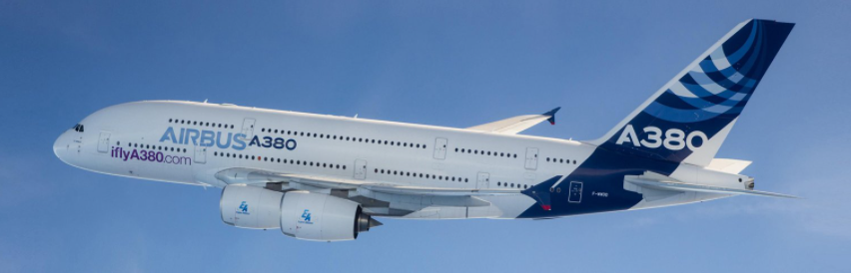
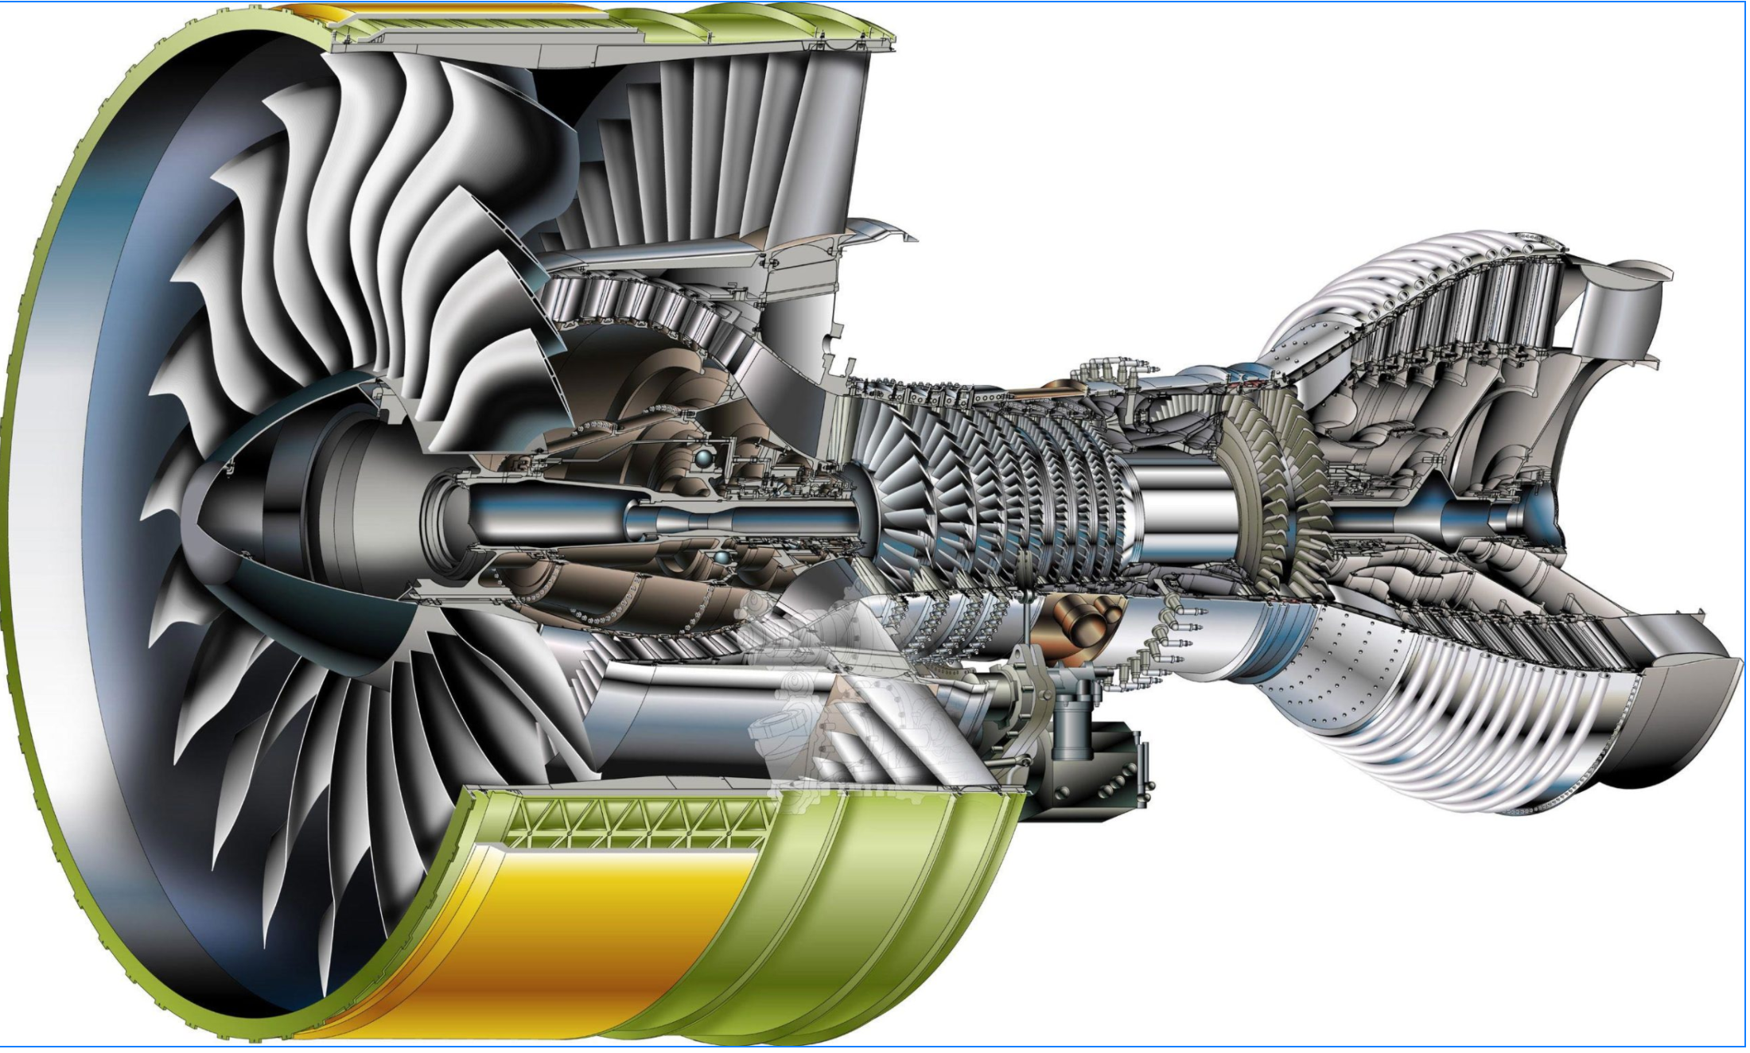
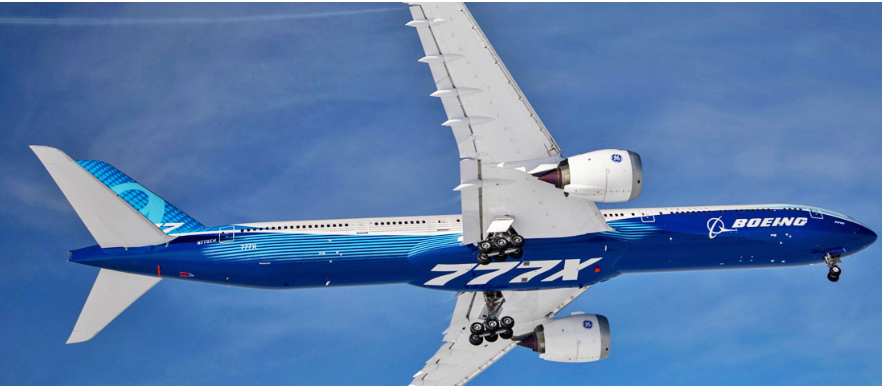
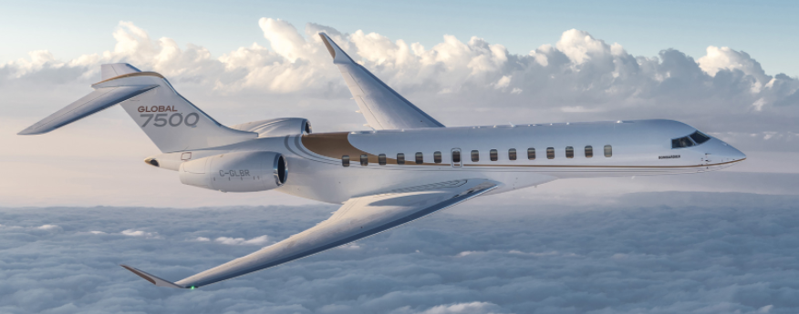
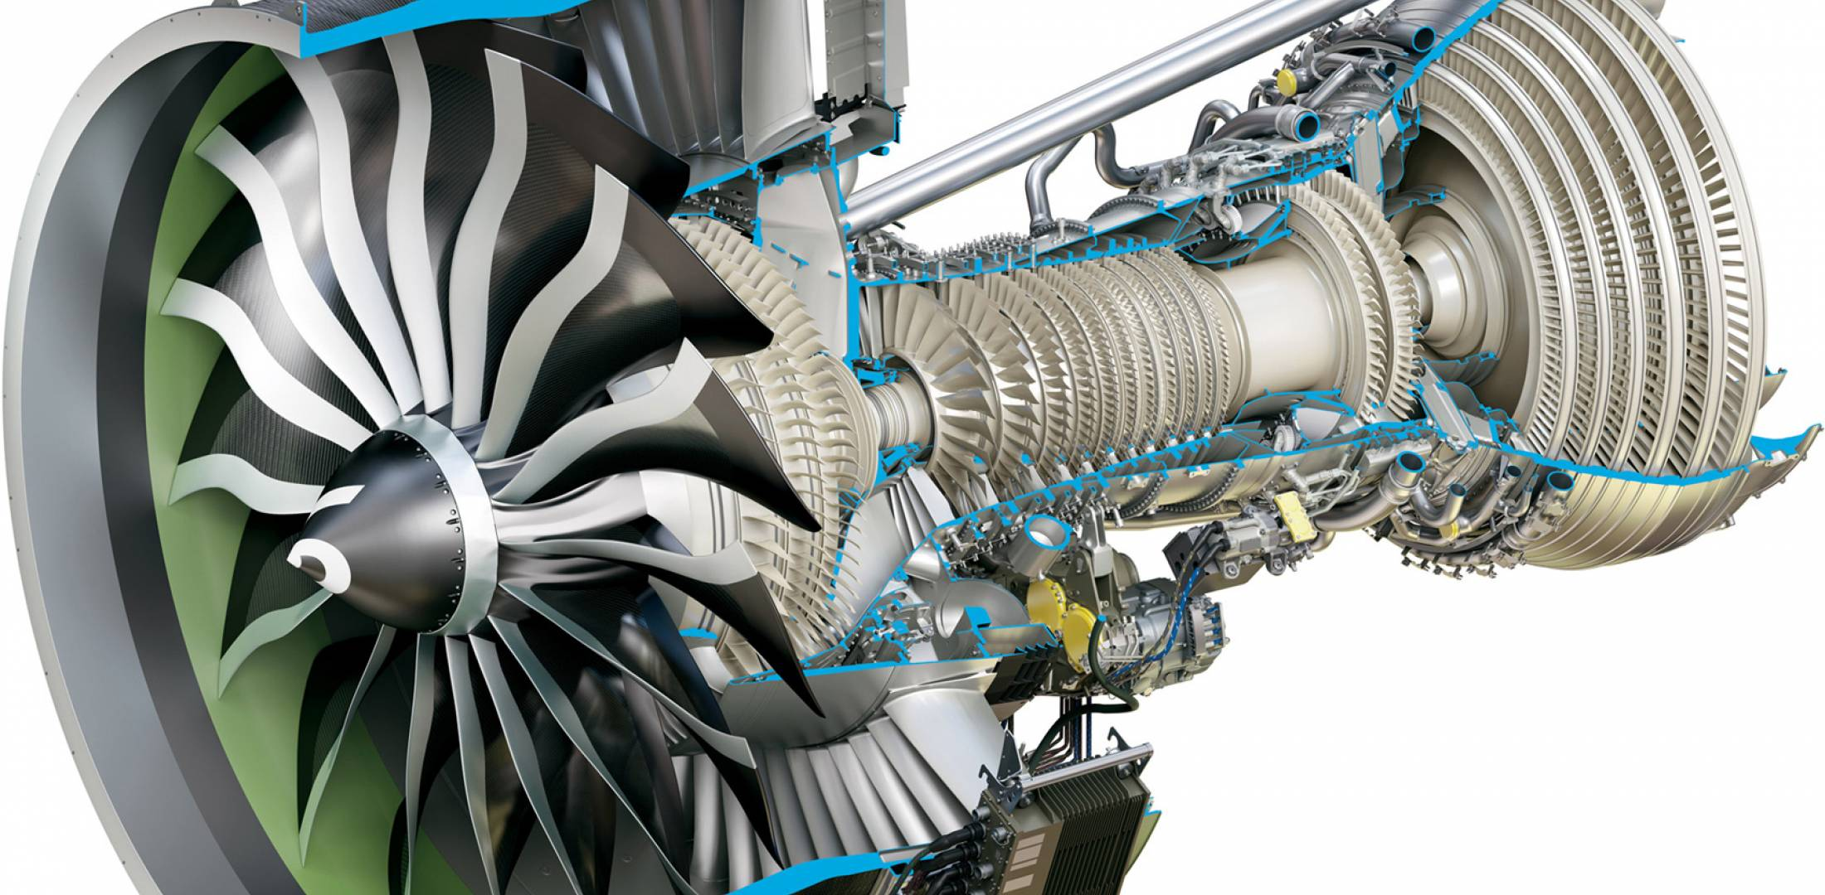
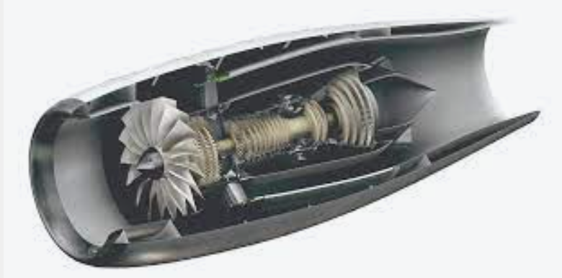
Sherry Liang – Career at GE Aviation
Boeing 737 MAX
Advanced Lead Engineer
(Sept ‘21-present)
Blade redesign
Advanced Lead Engineer-Mechanical Component
Summary
Military
Lead Engineer
(1 year)
Blade and shroud hardware owner
Expertise in low & high pressure turbine blade design/hardware ownership
Skills: Stress/heat transfer analysis, repair, clearance stack ups, drawing changes and substantiation to address cost out, producibility, and durability improvements, root cause assessments
Material Review Board (MRB) certified
Leader of Sealing Patent Research Committee on GE Aviation Design Board
Services Engineering committee leader
Variable Cost Lab
Bubble Assignment
(0.5 year)
Metal Injection Mold Technical Expert/Program Lead
Boeing 777 (GE90)
Lead Engineer
(1 year)
High Pressure Turbine Blade hardware ownership, field root cause, producibility
Airbus A380 (GP7000)
Design/Repair Engineer
(1 year)
High Pressure Turbine Blade hardware design and repair ownership, redesign and cost out projects
Boeing 777 (GE90)
Edison-3rd rotation
(1 year)
High Pressure Turbine blade hardware ownership, cost-out projects, field root cause, producibility and cost out
Boeing 777X (GE9X)
Edison-2nd rotation
(1 year)
Fuel system design engineer
for First Engine To Test
Bombardier (Passport 20)
Edison – 1st rotation
(1.5 years)
Oil system ownership, design & analysis, certification process, engine assembly and test
Start date: February 2014
Placeholder confidentiality disclosure.

Slide 4
GE Aviation BB2C Rockwell Collins College Projects
Summary
Expertise in low & high pressure turbine blade design/hardware ownership
Skills: Stress/heat transfer analysis, repair, GD&T, clearance stack ups, drawing changes and substantiation to address cost out, producibility, and durability improvements, root cause assessments
Material Review Board (MRB) certified
Leader of Sealing Patent Research Committee on GE Aviation Design Board
Services Engineering committee leader

Slide 5
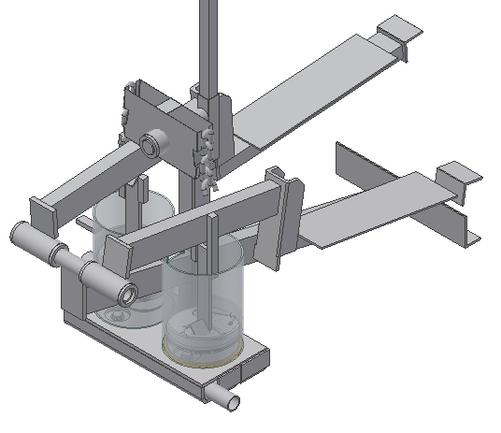
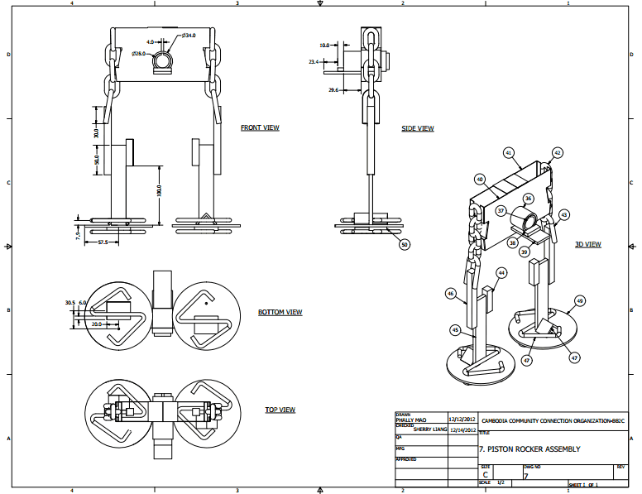
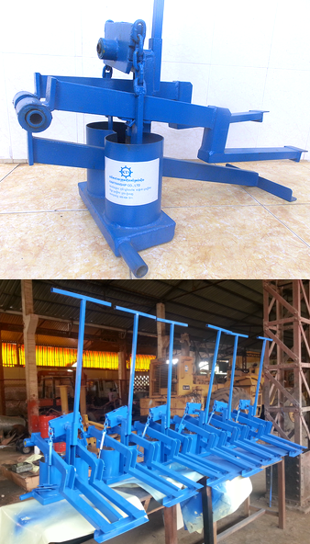
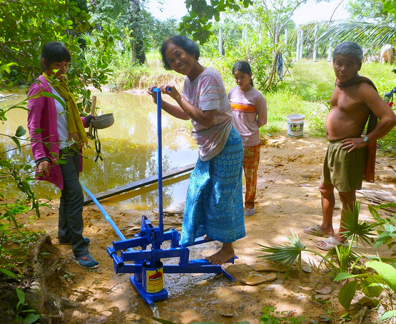
GE Aviation BB2C Rockwell Collins College Projects
Lead mechanical engineer at NGO in Cambodia, Brooklyn Bridge to Cambodia
After conducting market research of current irrigationpump technology, I lead the production of manual irrigation pumps for rural farmers which included the following activities:
Worked with 3D CAD software to produce technical drawings with manufacturing instructions; designed jigs and fixtures for quick and precise production
Finding and evaluating local manufacturers to manufacturer pump, quote evaluation and material sourcing
Writing quality control procedures and working directly with the suppliers to provide design and technical support during pump production
Conducting performance testing and quality control testing
Conceptualized and prototyped different designs for a new pump design

Slide 6
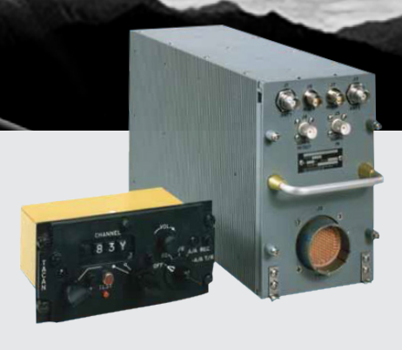

GE Aviation BB2C Rockwell Collins College Projects
Mechanical Engineer Graduate Co-op
TCN-500 / AN/ARN-153(V) Advanced Digital TACAN Receiver-Transmitter for F-15SA
• Performed board and system level thermal analysis using Computational Fluid Dynamics to model the effects of conduction, convection, and radiation in order to predict product’s performance in severe environmental conditions
Determined which components needed to be replaced that didn’t meet the guidelines
Software Used
FloTHERM® is a CFD software that was used to simulate airflow and heat transfer in and around the unit, including the coupled effects of conduction, convection, and radiation.
FloTHERM® PACK
FloEDA Bridge
FloMCAD Bridge

Slide 7
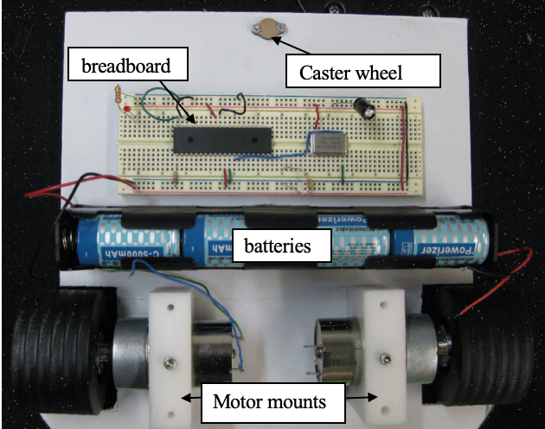
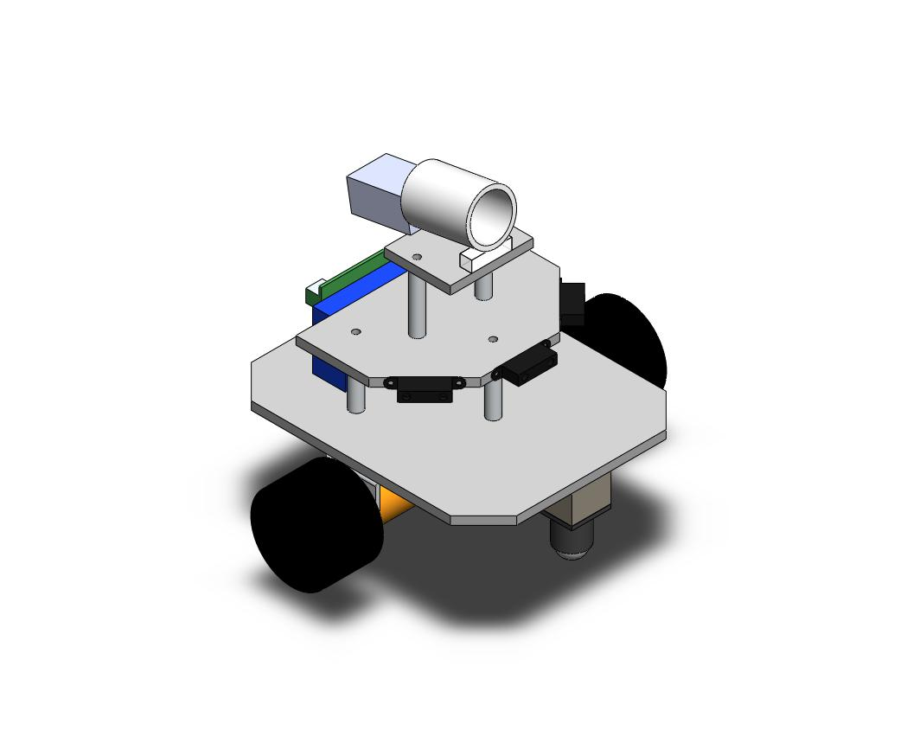
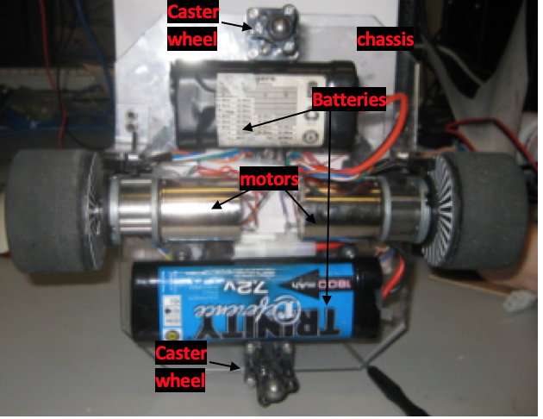
GE Aviation BB2C Rockwell Collins College Projects
Robotics
Sumo Robot Competition
For my Mechatronics course, designed the mechanical and electrical aspects of an autonomous robot for a sumo robot component
Programmed a microcontroller to take inputs from infrared sensors and drive the motors accordingly to push component out of a ring
Tank Battle Competition
Worked on team to design and debug an autonomous mobile robot that was equipped with infrared range sensors for obstacle avoidance, wheel encoders for dead-reckoning, and a solenoid for launching balls

Slide 8
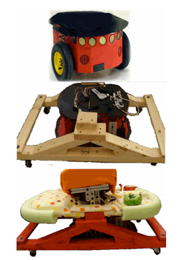
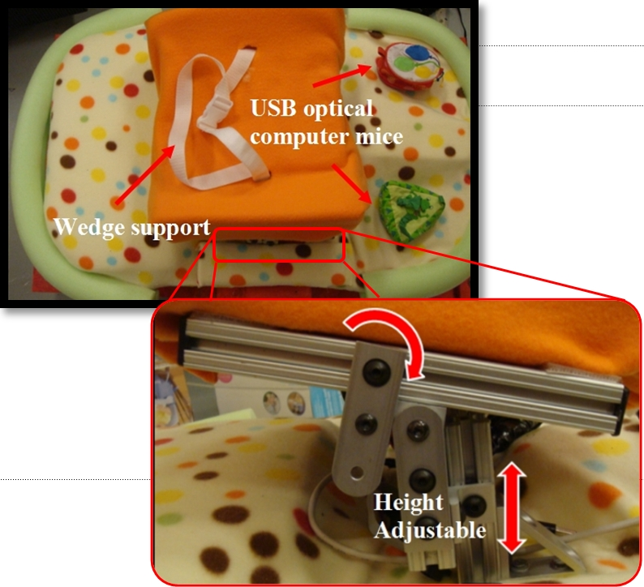
GE Aviation BB2C Rockwell Collins College Projects
Robotics
I helped program a commercial robot equipped with ultrasonic sonar sensors, which had to navigate a maze and find the shortest possible route from start to finish. Acting as a surveillance robot, it then relayed this information to a second robot.
At the University of Delaware for a National Science Foundation, Research Experience for Undergraduates (REU) summer project, I worked on a human-robotic interface for children with mobility impairments. I conceptualized, designed, and constructed a prototype that integrated the use of optical sensors with a commercial robot

